Slide 1
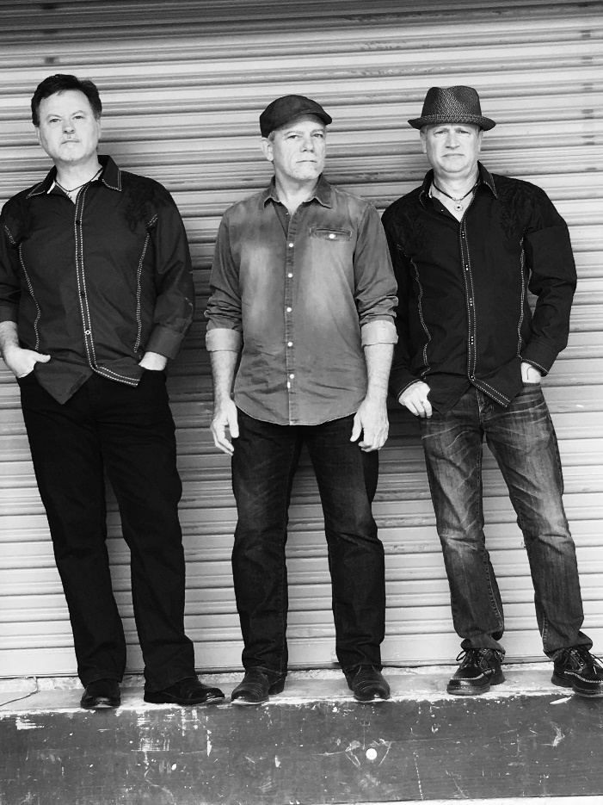
The 3 Amigos
The 3 Amigos consist of 3 talented local musicians, Trace Mitchell, Joe Mansir and Randy Jeter. They perform a combination of classic to current rock, pop and country hits from the 70's through today. These professional musicians have performed with popular bands throughout the USA and abroad! Audiences will be engaged from the first note to the last with their "feel good" and interactive performance ...Guaranteed to rock your soul!
Connect with The 3 Amigos
Website: http://www.the3amigosband.com
Facebook: https://www.facebook.com/the3AmigosMusic/?fref=ts
Youtube: https://youtu.be/mcAx6BblGGk

Slide 2
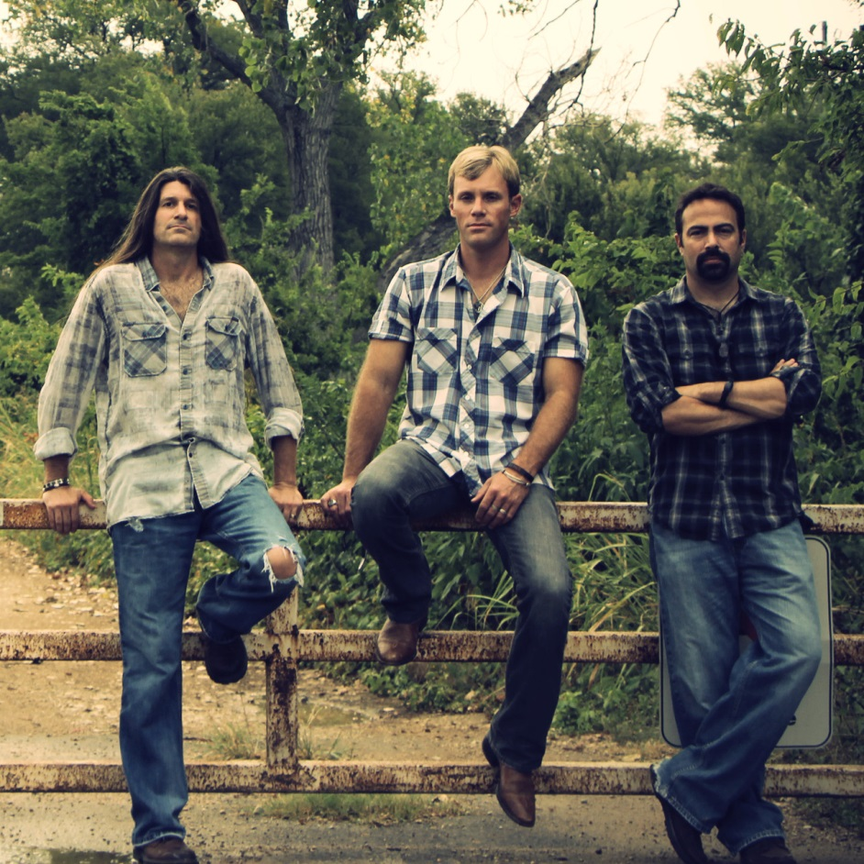
Zack King Unplugged
Zack King and his band have been performing their unique brand of Texas Rock across the U.S. for over 13 years. In that time they have played with some of the most illustrious superstars in rock and country music. They kicked off their career opening for legendary singer/songwriter Leon Russell and have since performed with the likes of Bon Jovi, Alabama, Chris Cagle, Bret Michaels, Randy Travis, Keith Anderson, Kevin Fowler, Stone Temple Pilots, Tesla, Ronnie Milsap, Monte Montgomery and many more.
The NHL's Dallas Stars have been using Zack King songs for years both at Dallas' American Airlines Center during home games as well as in advertising and promotion for the team. Most recently, the band's single "What Do You Say" is being used by CBS Television in Dallas/Fort Worth to promote current programming. Their song "Big Plan In The Southland" is the theme song for CBS' DFW Outdoorsman. The band has also released four successful Christmas Classics in their own unique "unplugged" style.
The Zack King Band brings their fun stories and "unplugged" show to the Zin Zen Wine Bistro.
Connect with Zack King Unplugged
Website: www.ZackKing.com
Facebook: www.facebook.com/ZackKingBand
Twitter: https://twitter.com/ZackKingStudios
Instagram: https://www.instagram.com/zackkingband
YouTube: https://www.youtube.com/user/zackkingband

Slide 3
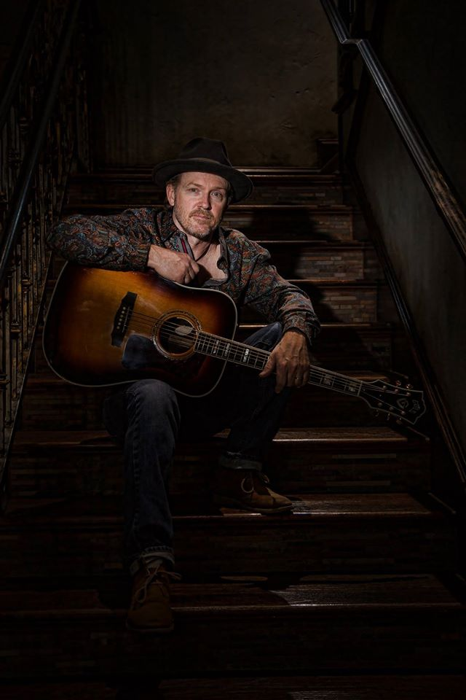
Shane Frame
Shane Frame is a Texas singer songwriter and multi instrumentalist from McKinney Texas. His back story is filled with experiences touring across the country performing and penning songs in Nashville with some of the best songwriters the music industry has to offer.
A 5 year old boy, the Ed Sullivan Show, and the Beatles. For me that was a recipe that stirred up a passion that to this day burns deep in my soul. Music consumed my life as a child and as an adult. I am one of the blessed few fortunate enough to make it my profession for so many years. It has taken me to places I never dreamed as well as taken me back to times I will never forget. After 20 years in the music business, working and living in Nashville Tennessee, I relocated back to Texas and went into semi retirement to focus on a family and a business career. I am very blessed to have partnered up with two of the most awesome souls on the planet, George Fuller and Maylee Thomas, to establish The Guitar Sanctuary and Performance Academy in McKinney Texas. The worlds coolest boutique guitar shop and music school. There I am able to share my passion and experience for music with up and coming artist through mentoring and performance programs. I still perform weekly in the McKinney, Allen, Plano, & Frisco Texas doing my originals and unique unplugged versions of songs that keep us young.
Connect with Shane Frame
Website: shaneframe.com
YouTube: https://www.youtube.com/watch?v=yUx9kOBT1QE

Slide 4
Tyla Taylor
I've been fortunate enough to be involved with and learn from some of the most talented musicians Dallas has to offer.
It all started on the hearth of my childhood home in Mesquite, Texas. Although, I was never actually a 'Skeeter', like my grandparents, my parents and my brother...and I moved to Carrollton, TX when I was very young, I claim Mesquite as "the place I grew up".
As a child between the ages of 6-8, I would put a Crystal Gayle or Linda Ronstadt ALBUM on the turn table, stand on my hearth with my jump rope in hand (my Mic) and perform the entire album, both sides, at least twice.
My parents and my older brother were big musical influences for me. My Dad played guitar and sang with Mom beside him singing harmony. Mom grew up playing gospel songs on piano at the churches where her Daddy would preach. Brother played a little drums in the living room and a little guitar. I sang.
From the time I was old enough to sing it's ALL I EVER wanted to do. But, it wasn't until I was 22 that I ever really tried to seek out the opportunity to sing live. That's when a very patient man by the name of Robert Lee Kobb came into my life and gave me the chance I had so wanted. I say 'patient' because when I started trying to perform live I was really BAD! But Robert Lee taught me the ropes of the business and lucky for me, my local music career had begun.
We do accoustic classic and modern rock with a very eclectic mix of music in between.
Connect with Tyla
Website: http://tylataylor.com/

Slide 5
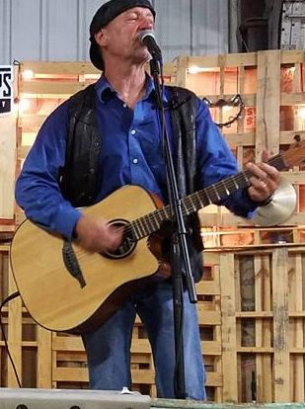
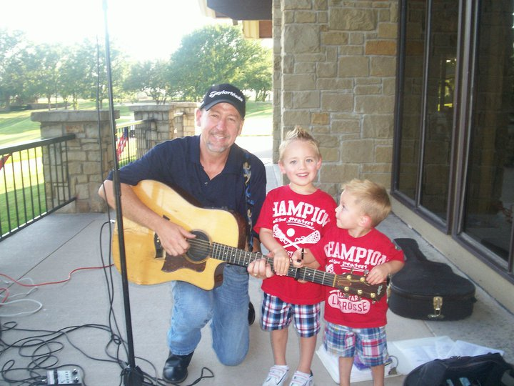
Eric Erickson
Eric Erickson has been performing in and around the D/FW area for the last 20 years at places like Zin Zen, Kirby's Steakhouse, Harvest, Lekka, Marcus Cafe, and others. Eric has a vast range of music in his song list, covers many styles of music, including over 800 selections of everything from John Mayer to George Strait. Eric and his family currently live in McKinney, Tx. For booking information please contact Eric at 972-547-4449 or eric1a@peoplepc.com
Connect with Eric
Youtube: https://www.youtube.com/watch?v=q3efndBoYvI

Slide 6
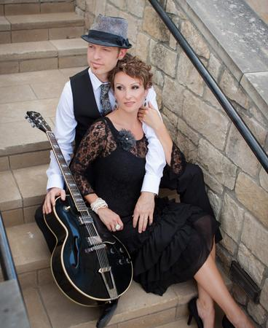
Reigning Nickels
Husband (Nick Knirk) and wife (Carly Reign) acoustic renderings of your favorite classic rock, blues, country, jazz and pop songs. Yes, it's really that eclectic! With over 15 years in the cover band business, our repertoire is crazy!
We draw from our experiences on the biggest stages with the best bands and bring you a show full of tastefully harmonized songs that'll have you singing along with us. Come hang out at our next show and see what all the fuss is about!
Connect with Nick and Carly
Website: www.ReigningNickels.com
Youtube: http://www.reigningnickels.com/youtube.html

Slide 7
Wyatt Martin
Twenty-five years is a long for someone to spend overseas especially if they’re just a few years older than that themselves. They may look American, they may talk American, they’re mannerisms and demeanor may not strike anyone as unusual, but their foundations are made of a different substance altogether.
I don't mean to say you can't relate to, or you won't find any common ground with that kind of person, people after all are people. I guess what it could be is that they've walked that other path. The one you've thought about sometimes after reading a book, or watching a YouTube video, or listening to your teacher talk about Africa. And you've thought "I wonder what that's like?" or "if I knew more about that, then maybe it would help me with a bit of this here". Maybe it would help you answer some questions you didn't even know you had. Questions like why do kids in China say their last name first, or why do ladies in Mexico kiss you on the cheek to say hello, or why do they speak so many languages in Uganda even though it's such a small country
Of course, Wyatt won't be answering those kinds of questions per se. As usual he'll be singing in riddles. Riddles that reflect some of those things he saw and felt on that "other path". He'll be playing his guitar with that somewhat unique acoustic/electric, coffee house, finger style with a hint of Blues sound. He'll be giving you little puzzle pieces, that if you'd like, you could use in your own puzzle. Maybe you could fill up some empty space that you think could use some filling or maybe you could build some bridges to some places you haven't been able to get to before. And if any of that sounds good or would make you happy then Wyatt would also be happy to have you come on by and watch one of his shows.
Connect with Wyatt
Facebook: https://www.facebook.com/wyatt.diamant

Slide 8
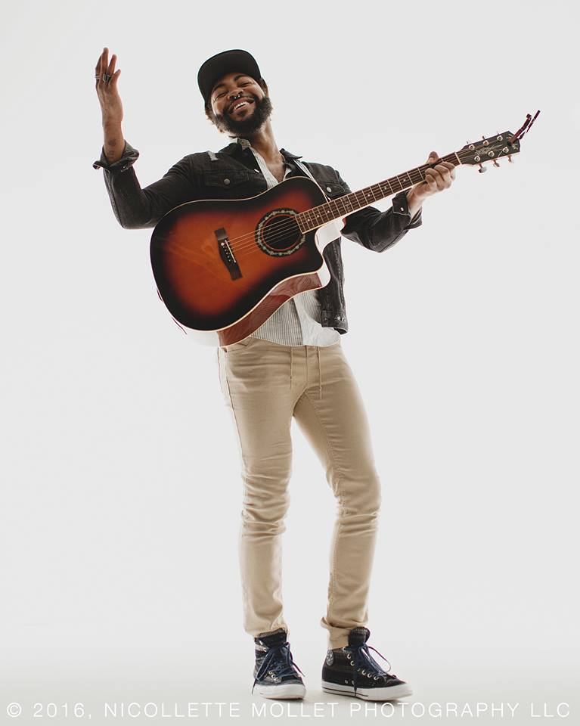
Luqman Rashada
Since 2011 Luqman has been making a name for himself around his city, Dallas, Texas. Some of his notable accomplishments include open call auditioning in Austin, Texas for The Voice: Season 6 in 2013. After many auditions, he was invited out to Los Angeles for The Blind Auditions, being 1 in 75,000 of auditioners to make it that far! Also, in 2015, he was asked to privately audition in Dallas to be a contestant on the final season of American Idol. That audition took him back out to L.A where he enjoyed a short stint on the show, performing his way through to Group Rounds. His time on the show came to an end shortly after, but not before a band member gave him wise words to continue on the journey that he had started.
AND HE HASN'T STOPPED YET!
Connect with Luqman
Website: https://luqmanrashada.com
Facebook: https://www.facebook.com/luqmusic1
Twitter: https://twitter.com/luqmusic1
Instagram: https://www.instagram.com/luqmusic/

Slide 9
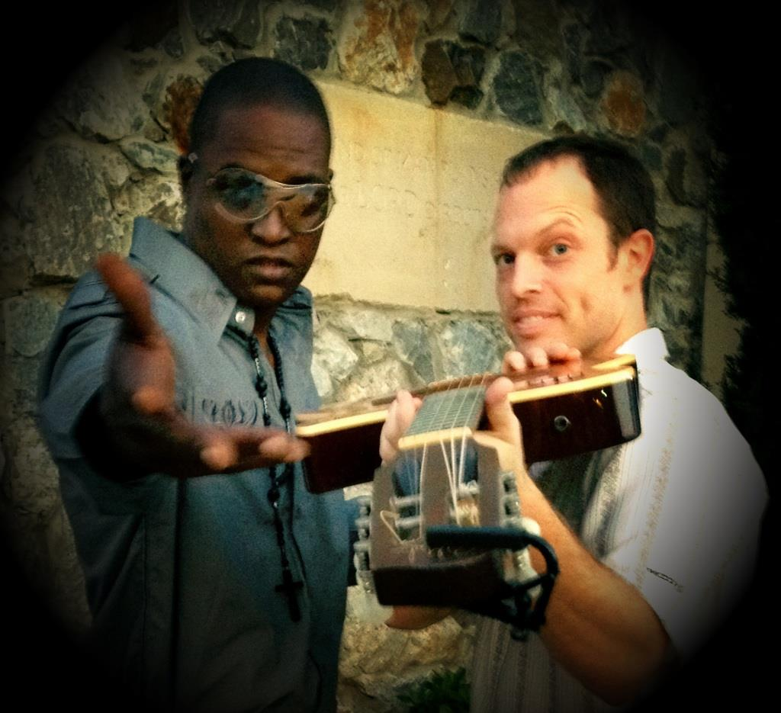
Nickel and Dime
Acoustic duo that features silky, soulful vocals and strong guitar picking!
Connect with Nickel and Dime
Facebook: https://www.facebook.com/nickelanddimeduo/

Slide 10
Secret Agent Men
Surf/Spy band. We do tons of 60's guitar instrumental tunes ala The Ventures and The Shadows and some originals too!
Connect with Secret Agent men
Facebook: www.facebook.com/thesecretagentmen

Slide 11
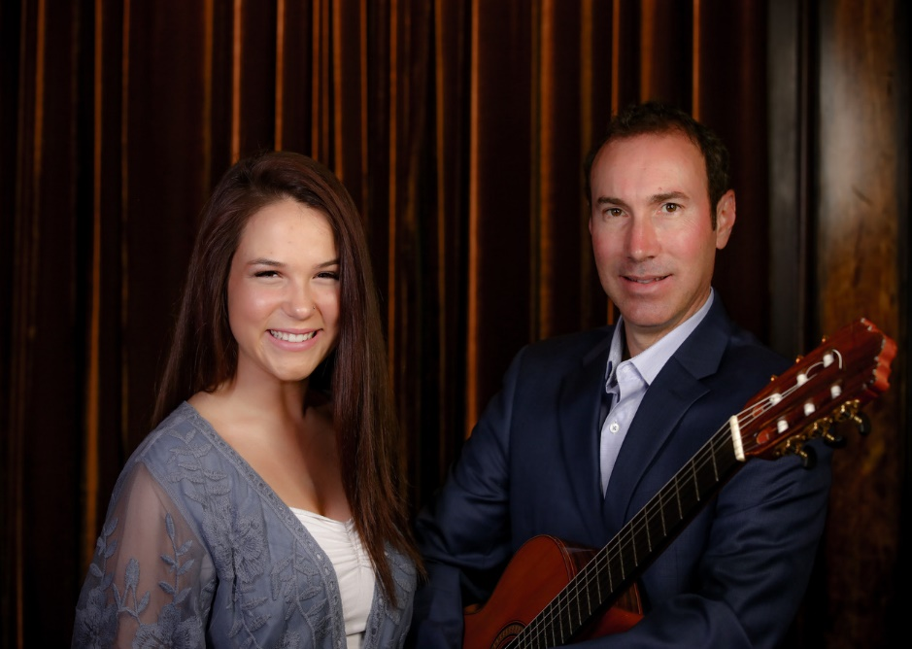
Acoustically Speaking
Acoustically Speaking featuring James Gabriano and singer/songwriter Alex Smolen captures elements of acoustic pop, classic rock, R&B, and smooth jazz. The combination of rhythmic acoustic guitar, soulful vocals, and tasteful percussion provides a classy backdrop to any venue. Specializing in current top 40 with an acoustic flair, Acoustically Speaking is able to connect with a diverse audience from any generation. The Trio is perfect for any sized event including corporate parties, weddings, grand openings, birthdays, and more.
Following the styles of Norah Jones, Ariana Grande, Adele, and Meghan Trainor, singer Alex Smolen brings a unique, soulful flavor to many classic and current songs.
Acoustically Speaking has performed for: Aretha Franklin, Kenny G, George Lopez, Lisa Loeb, Ross Perot, Mike Modano, and Tony Romo to name a few.

